Slide 1
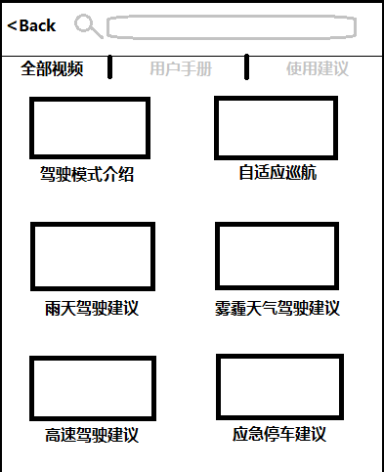
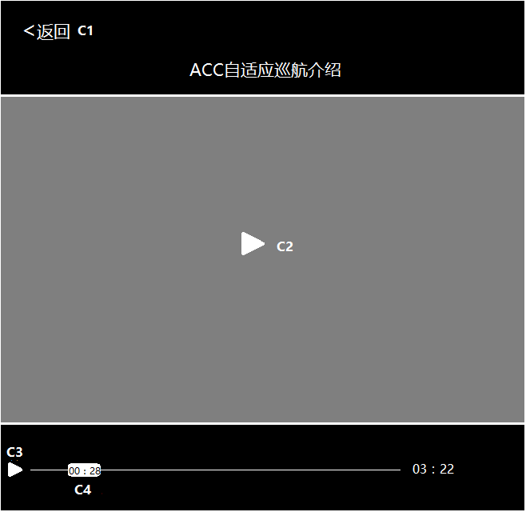
Videos for E-Manual
Requirement Description:
Videos introduce IVI main features, including operation and guidance
All videos within five minutes to maintain customers’ patience
Cover IVI top features
Videos need to have professional dubbing
Use Case Examples:
When customers want to know the detailed information of new features, they can directly click the “Videos” in E-manual
When customers want to know the detailed information of new features, they can trigger “VR” and say “Video Manual”
Customer Discernable Benefit:
Convenient to learn all features of the vehicle
Easy to compare with other brand vehicles
Improve customers’ experience
Enterprise Value:
Improve the user reputation
Save the cost of paper user manual
Platforming to cover more vehicle programs
Key Enablers / Potential Partners:
Voice Recognition: Baidu
Cloud Provider:
Target Markets:
China
Sketch/Picture:
Business Owner:
Feature Champion:
Feature Owner: Geng Dekang
Work stream Source:
Feature Funding Source:
Proposed Implementation Timing: SYNC+ Phase4
ONETIZATION
In Vehicle / Out of Vehicle Experience? x In □ Out □ Both
Projected Monetization:
Revenue at Point of Sale (of vehicle/service)__________________
Subscription / Pay Per Use Model _____ x __________________
B2B Model (e.g. from data sets) ___________________________
Other _______________________________________________

